Slide 1
TEMPUS
- Team eNRGy

Slide 2
Abstract
Tempus (Latin for “time”), is an android app which will help students in effective management of time.
It provides the student with all the information about courses such as time table, quiz/exam schedule, assignment deadlines etc.
It also has a public discussion forum wherein people can post important updates, and ask queries.

Slide 3
Introduction
Firstly, we will generate time-table given a user’s department and registered courses which will be provided by him at the time of SignUp. The user has complete flexibility to edit courses and department.
Our app will be open community, which means that anyone in the department can upload quiz/exam schedule for the whole department, which will be finalized/disregarded by each user as per their choice. Thus, this will be a provision to allow changes to the users’ “personal” schedule.

Slide 4
Motivation
The need of the hour demands that students should be deft at time management, which will be facilitated by our app. Our aim is to create a “one-stop platform” to keep track of all their activities, especially academic.
As most of us have felt, important messages are usually difficult to locate due to spamming on social media. So one of the motivations behind idea of this app is to cut short the spamming and deliver only relevant info.

Slide 5
Problem Statement
A Time-Table is made available to the user after they login/signup using their credentials. Also, there will be provisions to add time slots for tutorials, extra classes, quizzes, and assignments etc into the time-table. We will also implement categorized forums for different courses and common forum for whole department.

Slide 6
Software/Hardware Requirements
Android Studio
Android Emulator, Debugger
PHP
SQL
Java
phpMyAdmin
GitHub
000webhost (Online free webhost)
LaTex
JavaDoc

Slide 7
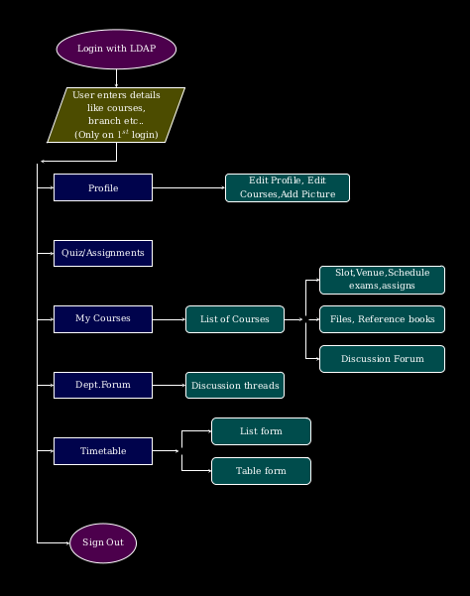
Implementation Flow Chart
(The one which was promised in the first presentation)

Slide 8
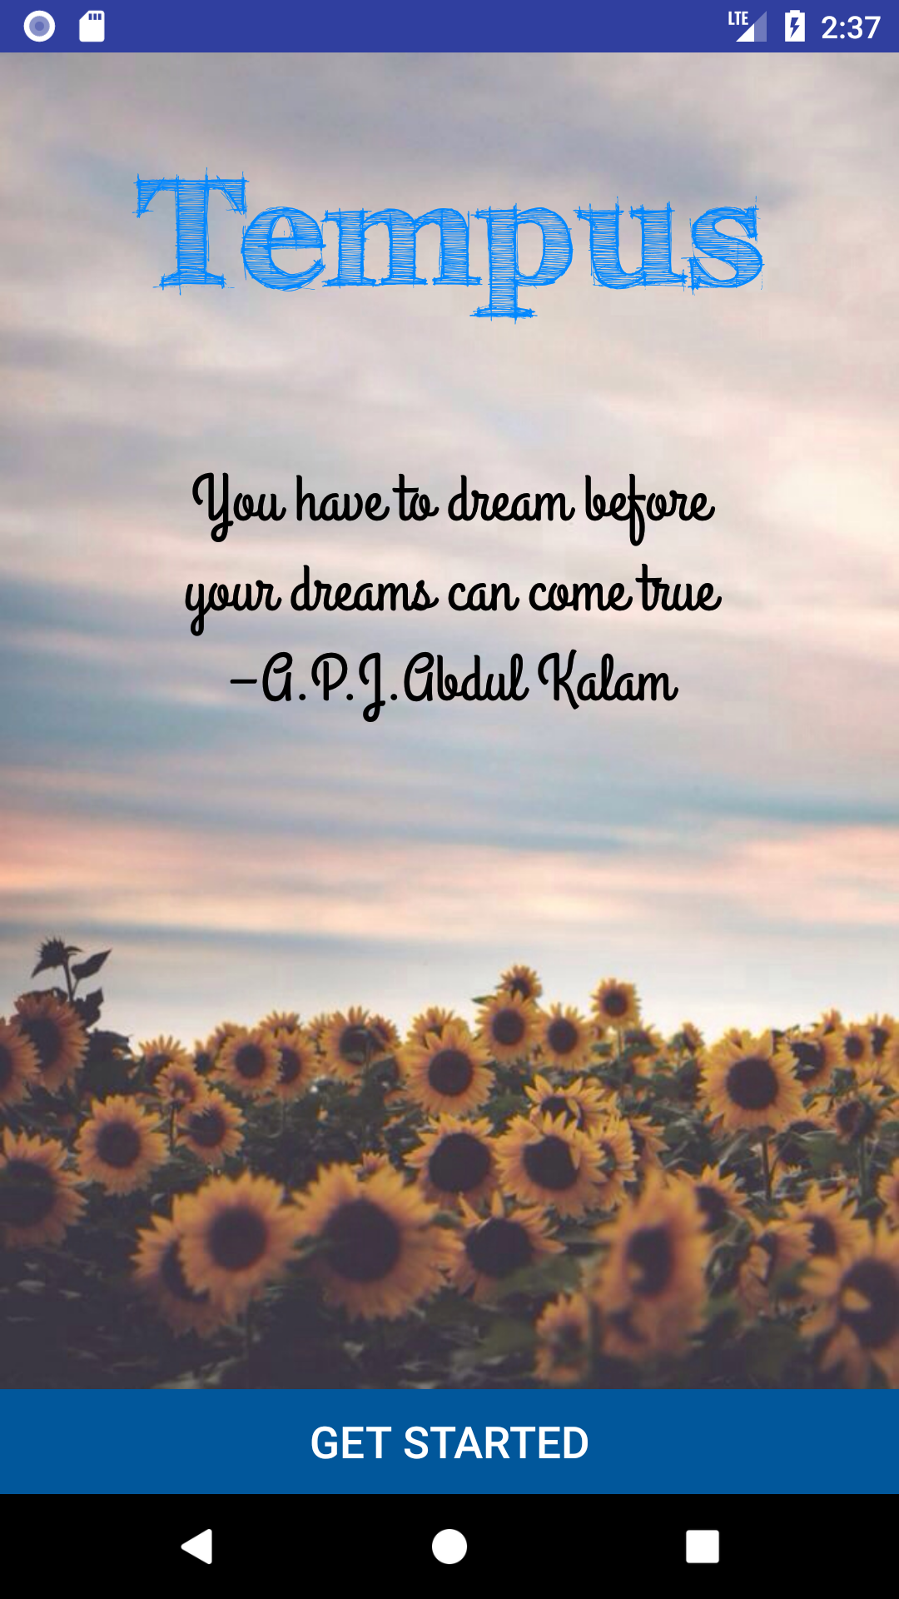
Welcome!

Slide 9
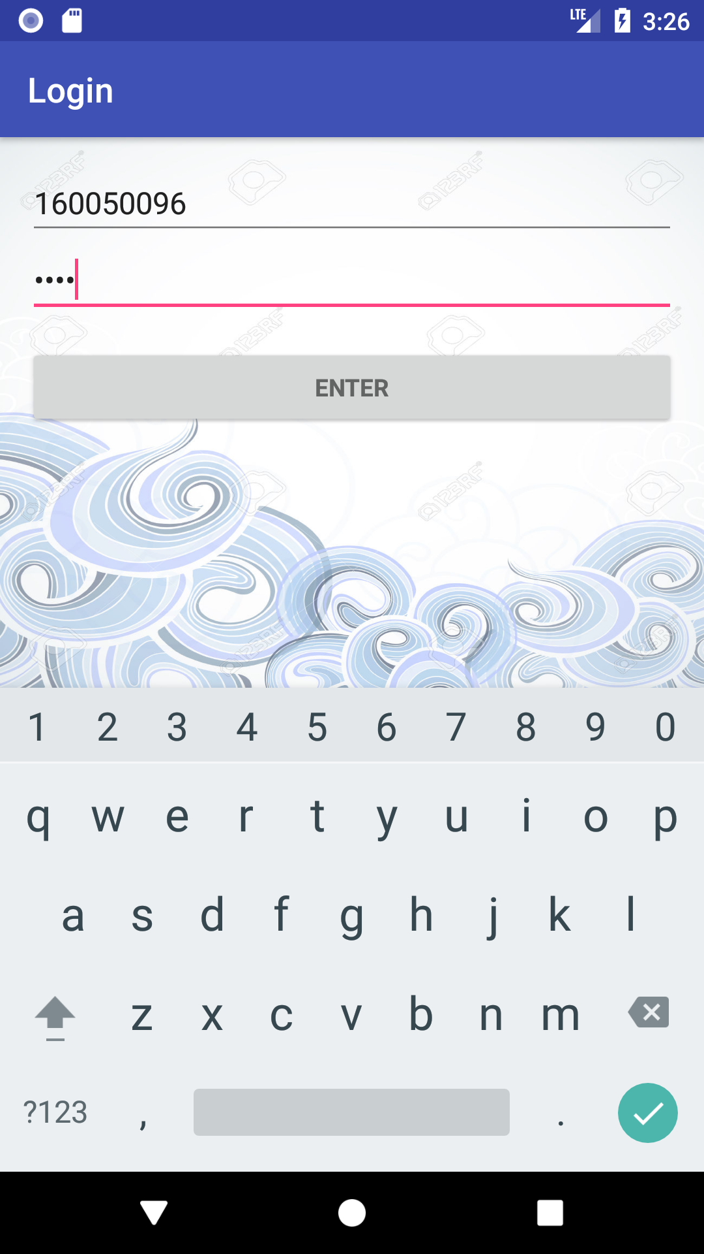
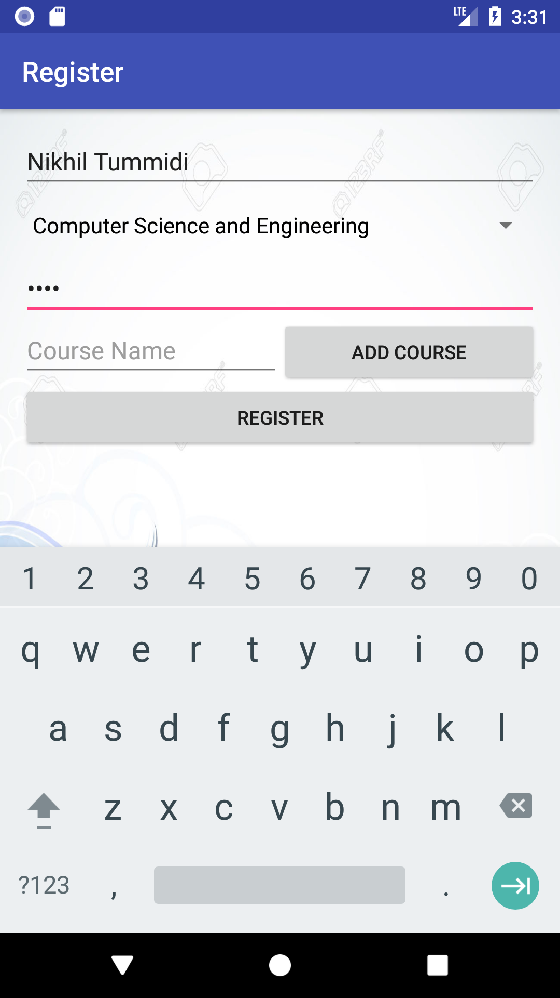
Login/Register

Slide 10
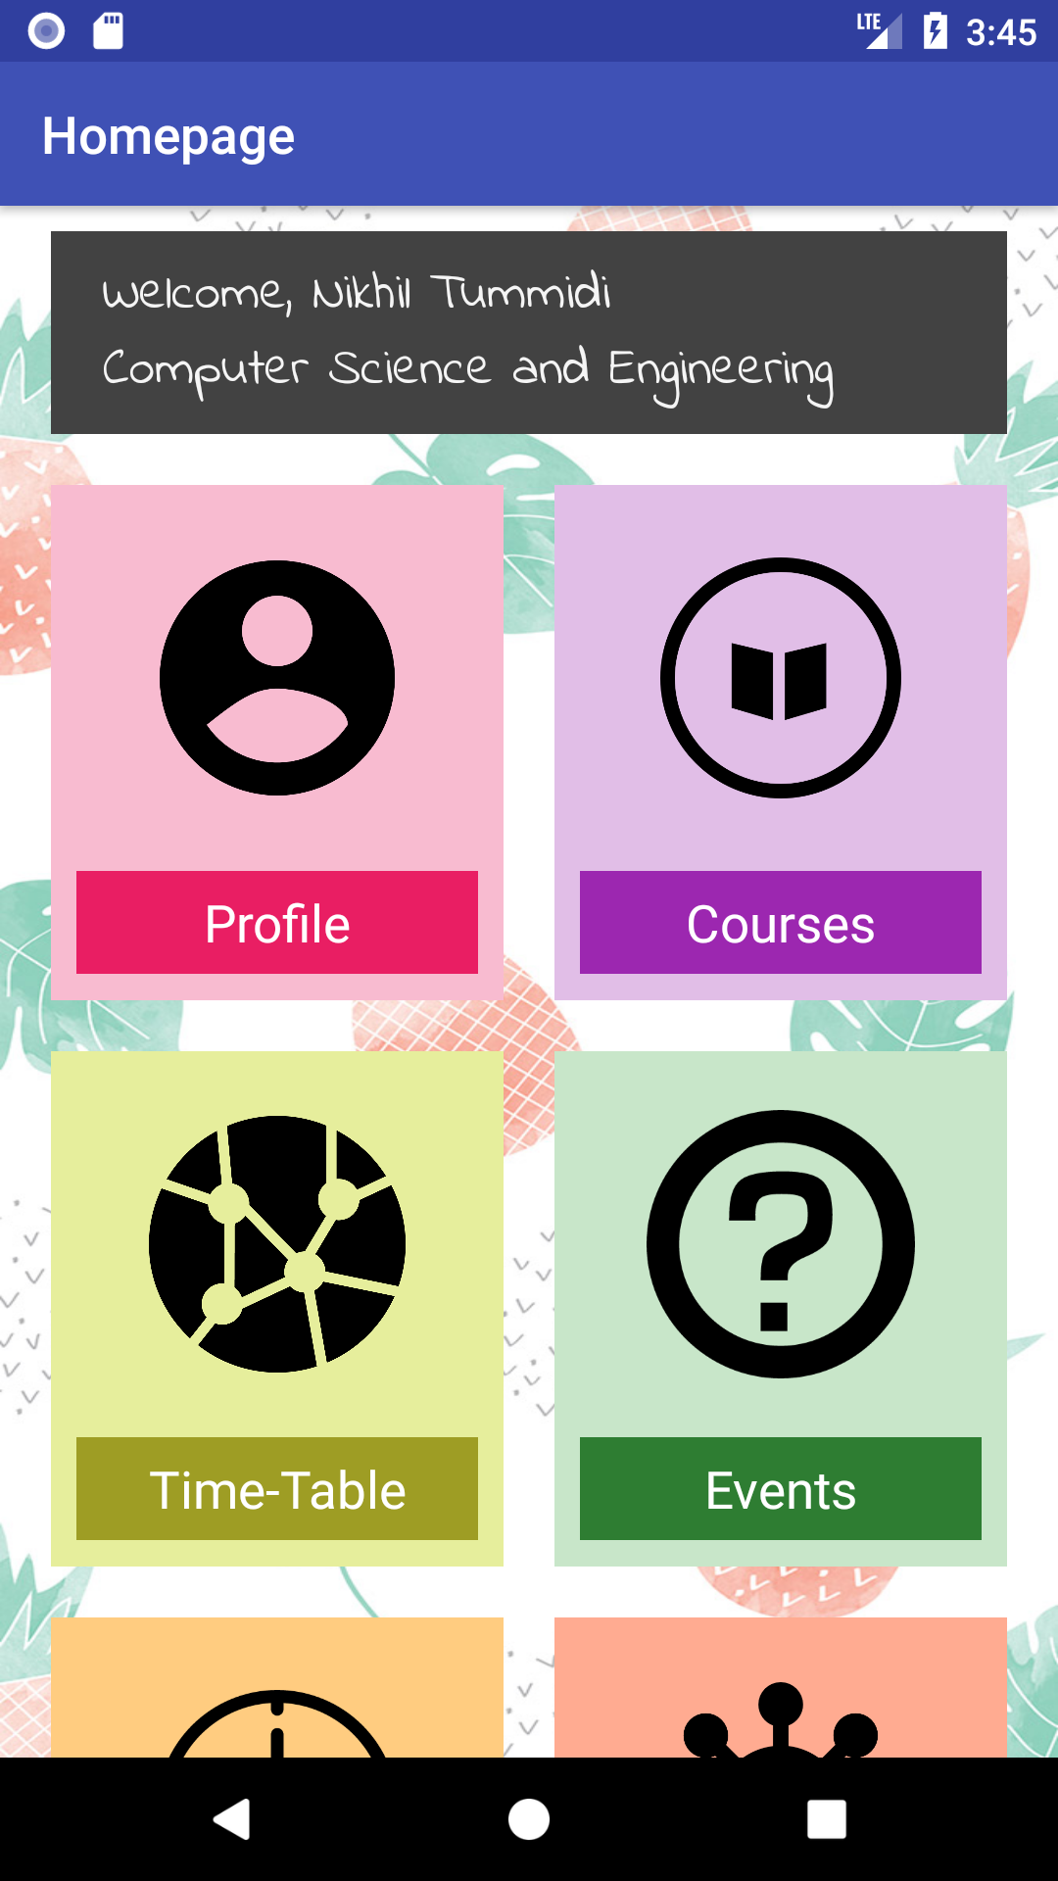
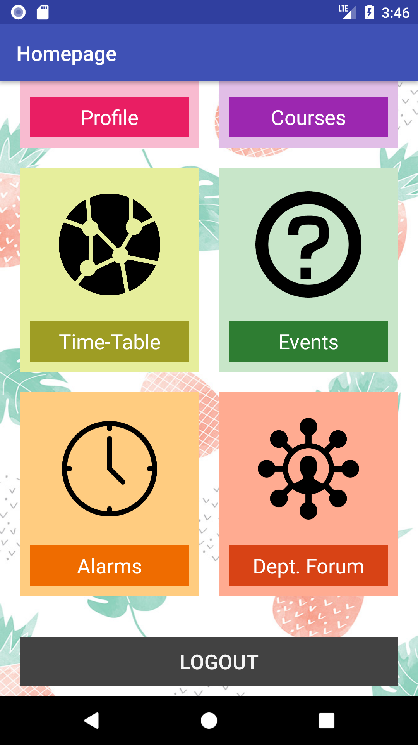
Homepage

Slide 11
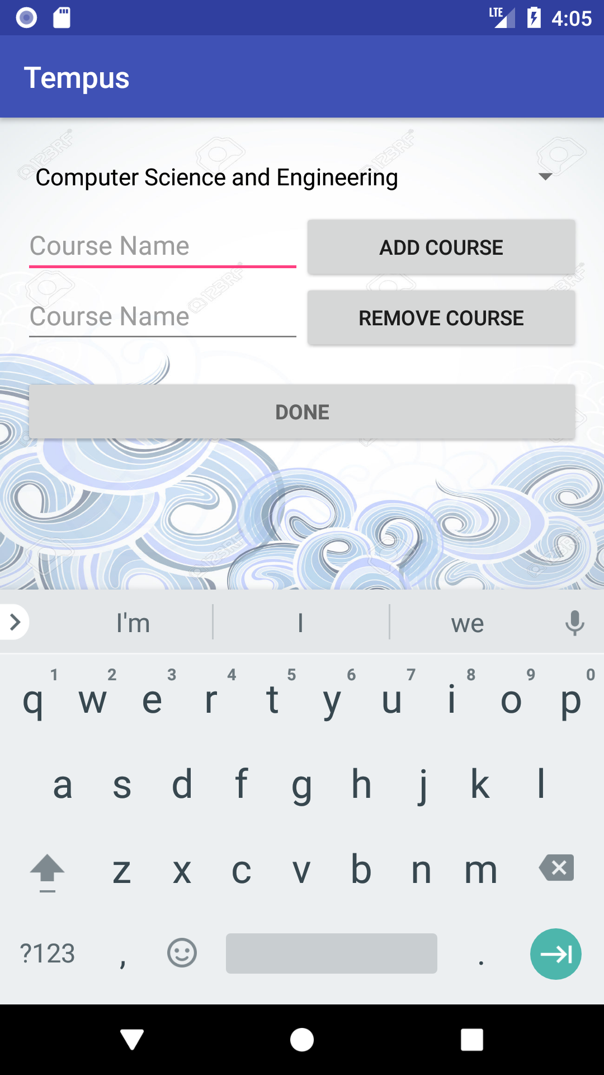
Profile

Slide 12
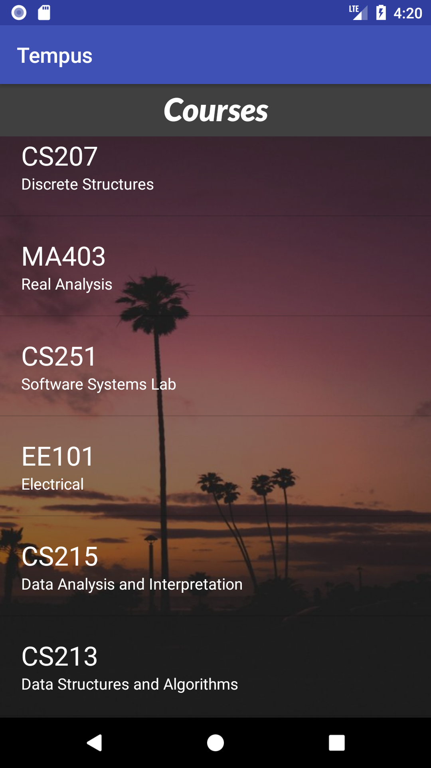
Courses

Slide 13
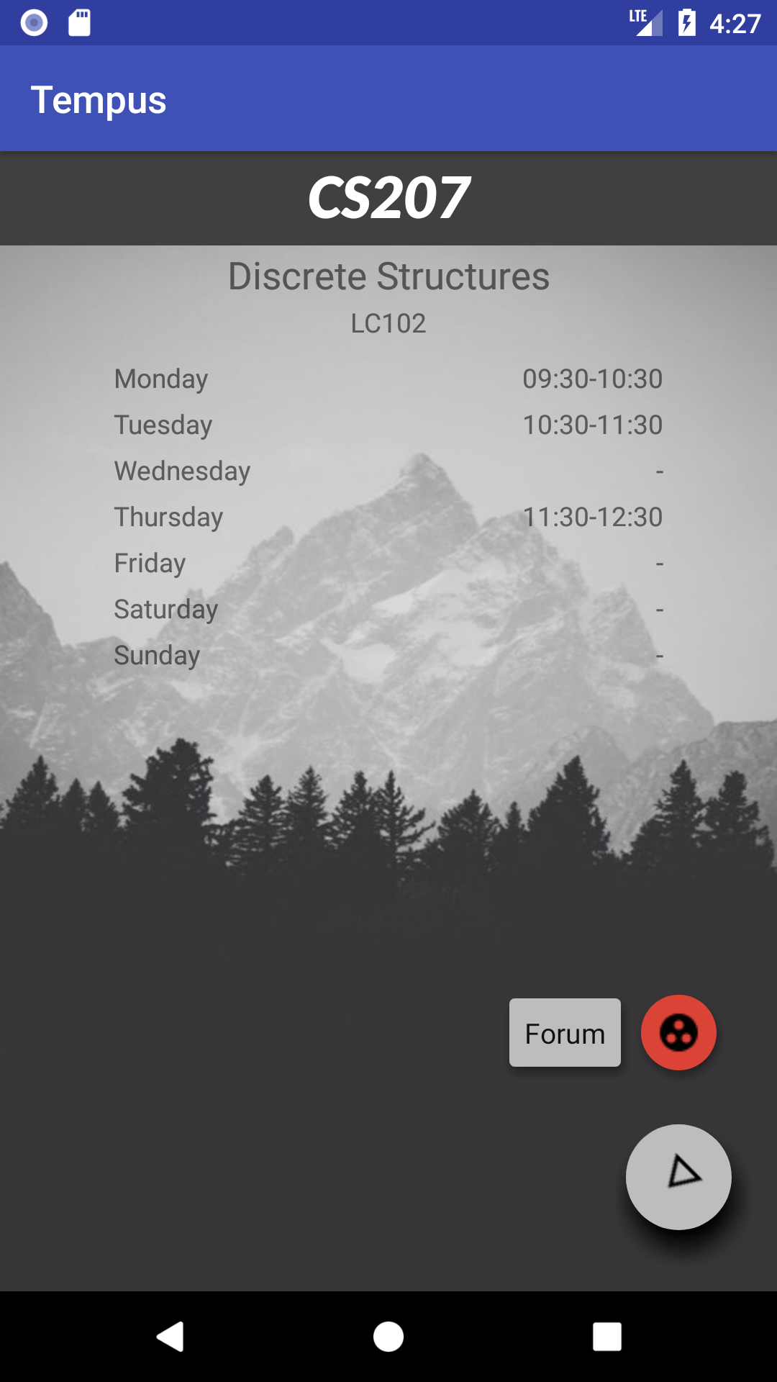
Courses in Detail

Slide 14
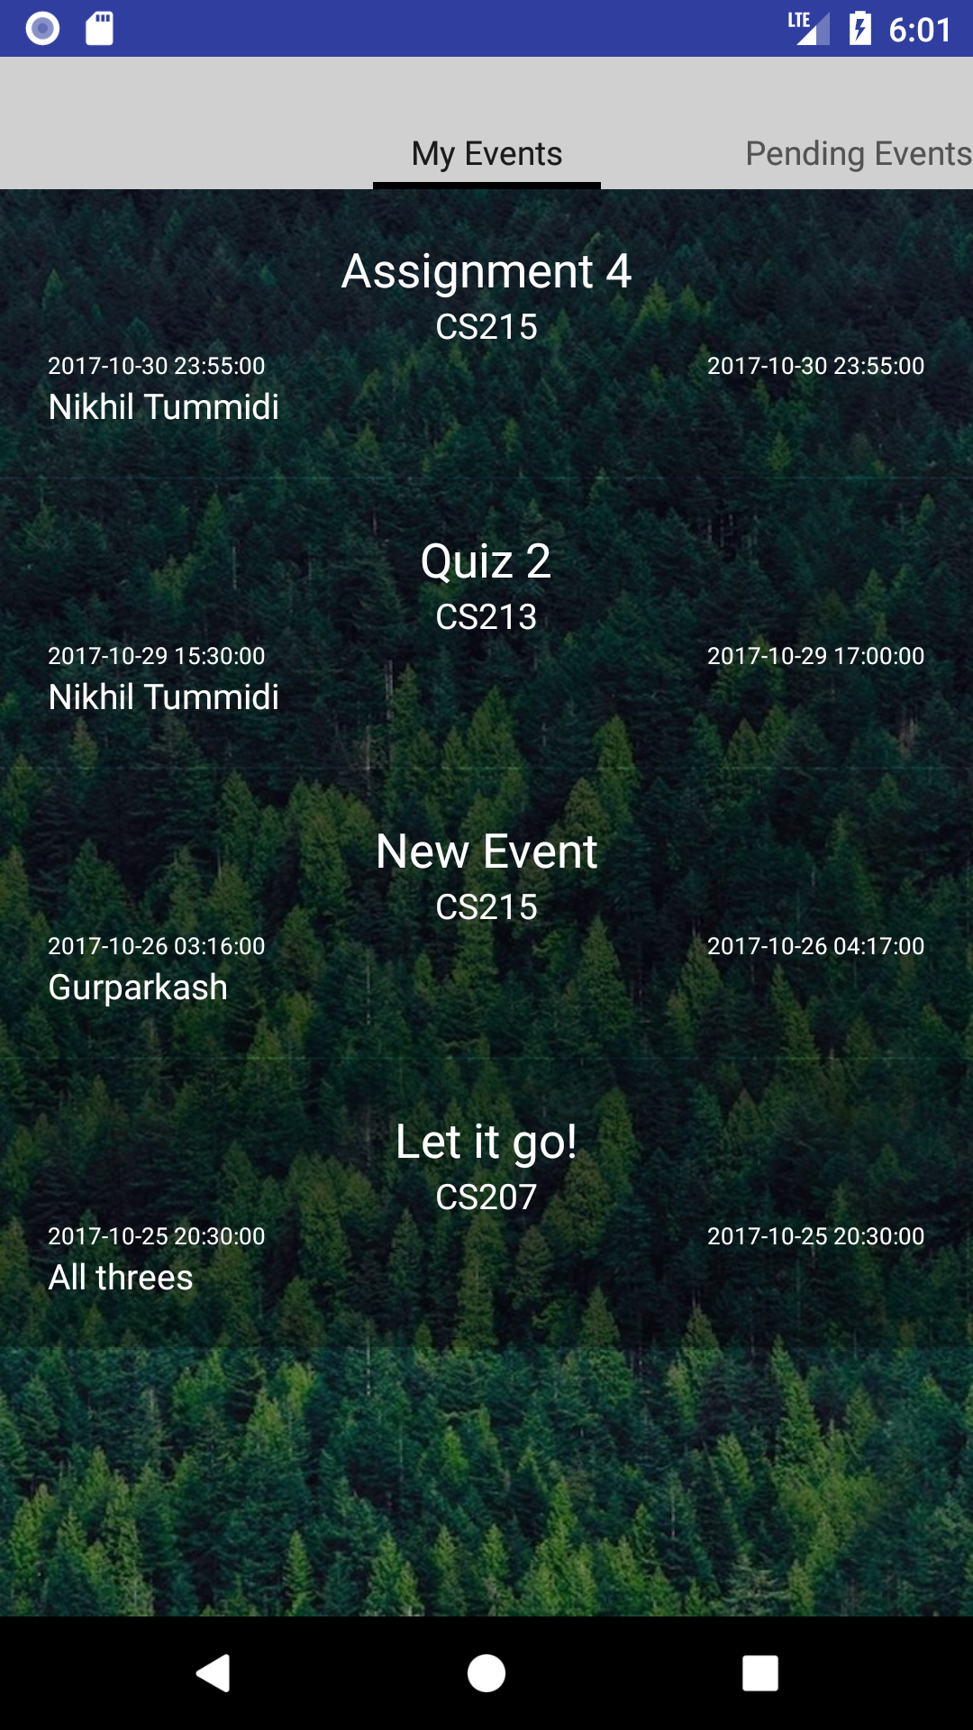
My Events

Slide 15
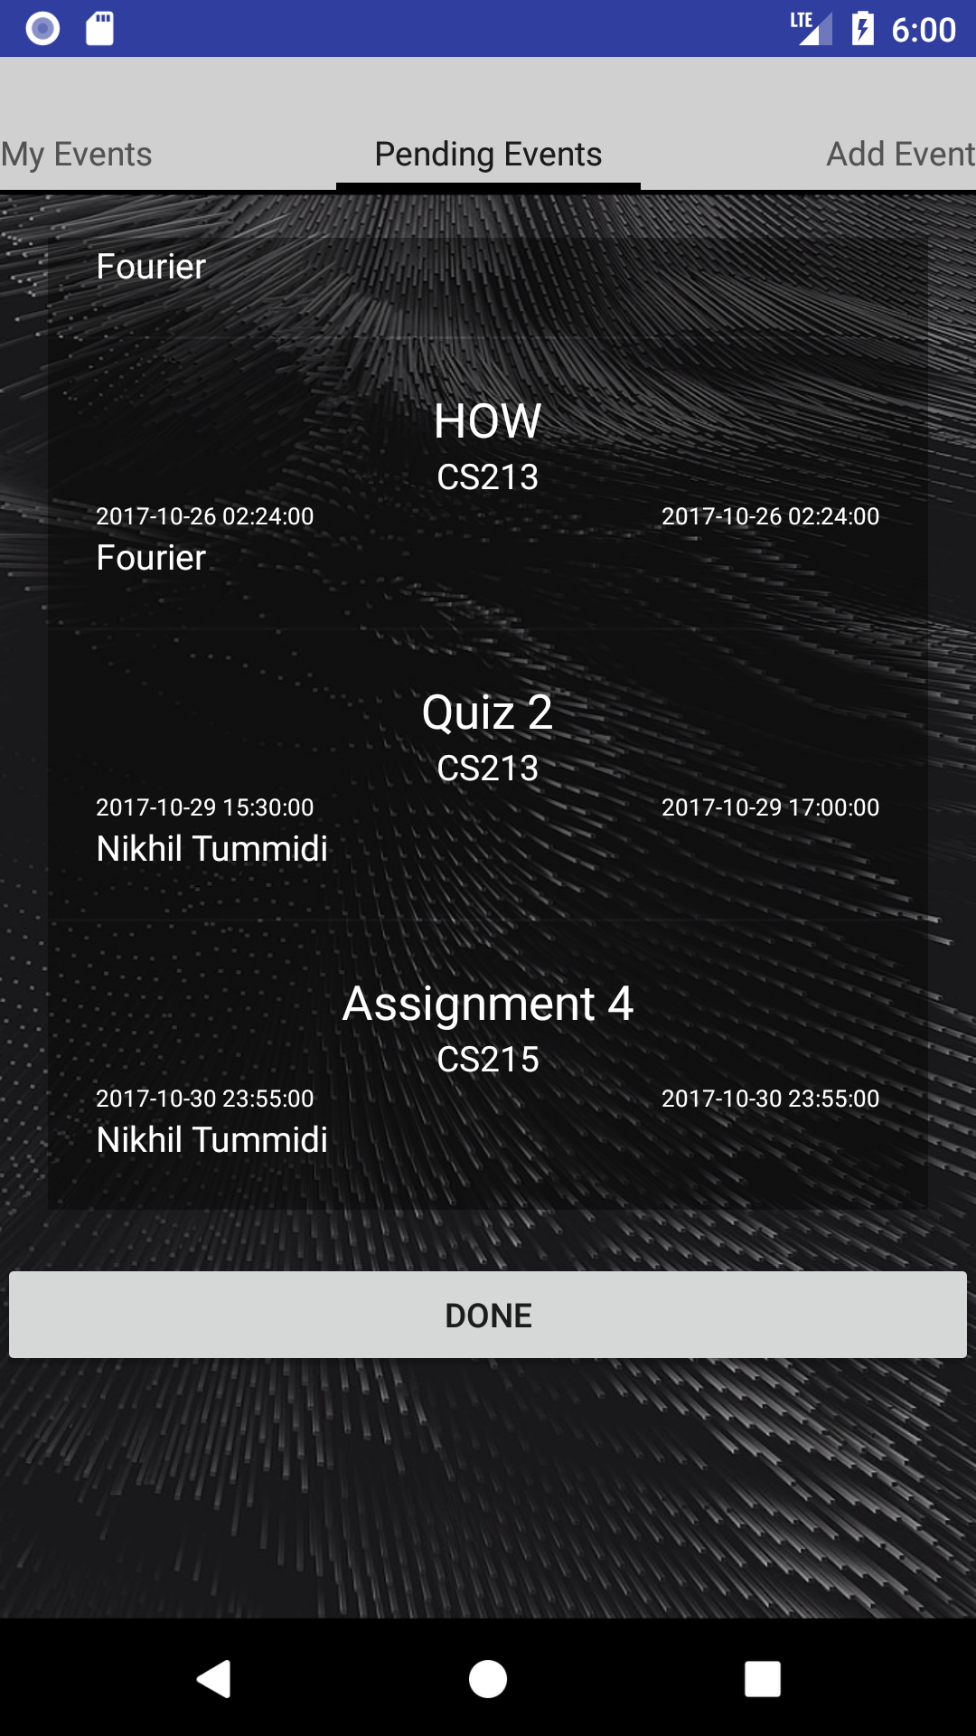
Pending Events

Slide 16
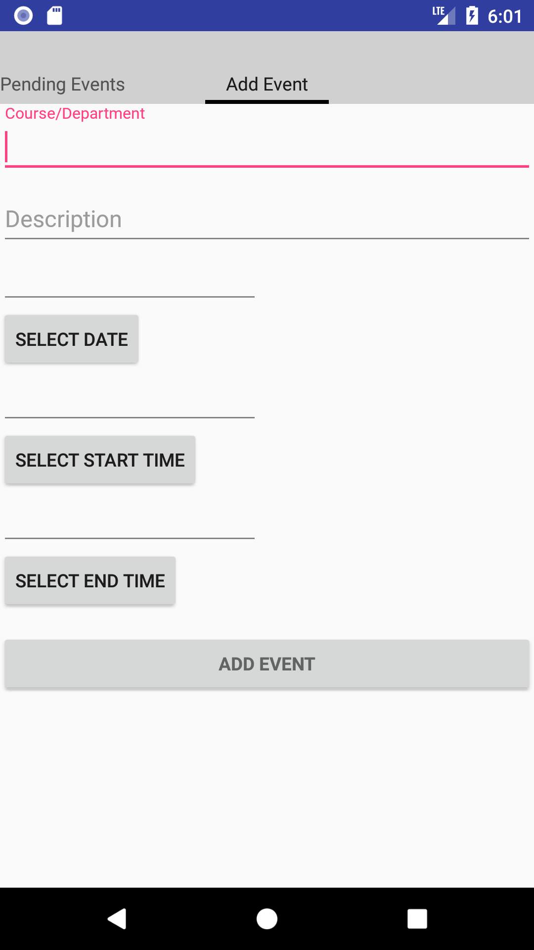
Add Event

Slide 17
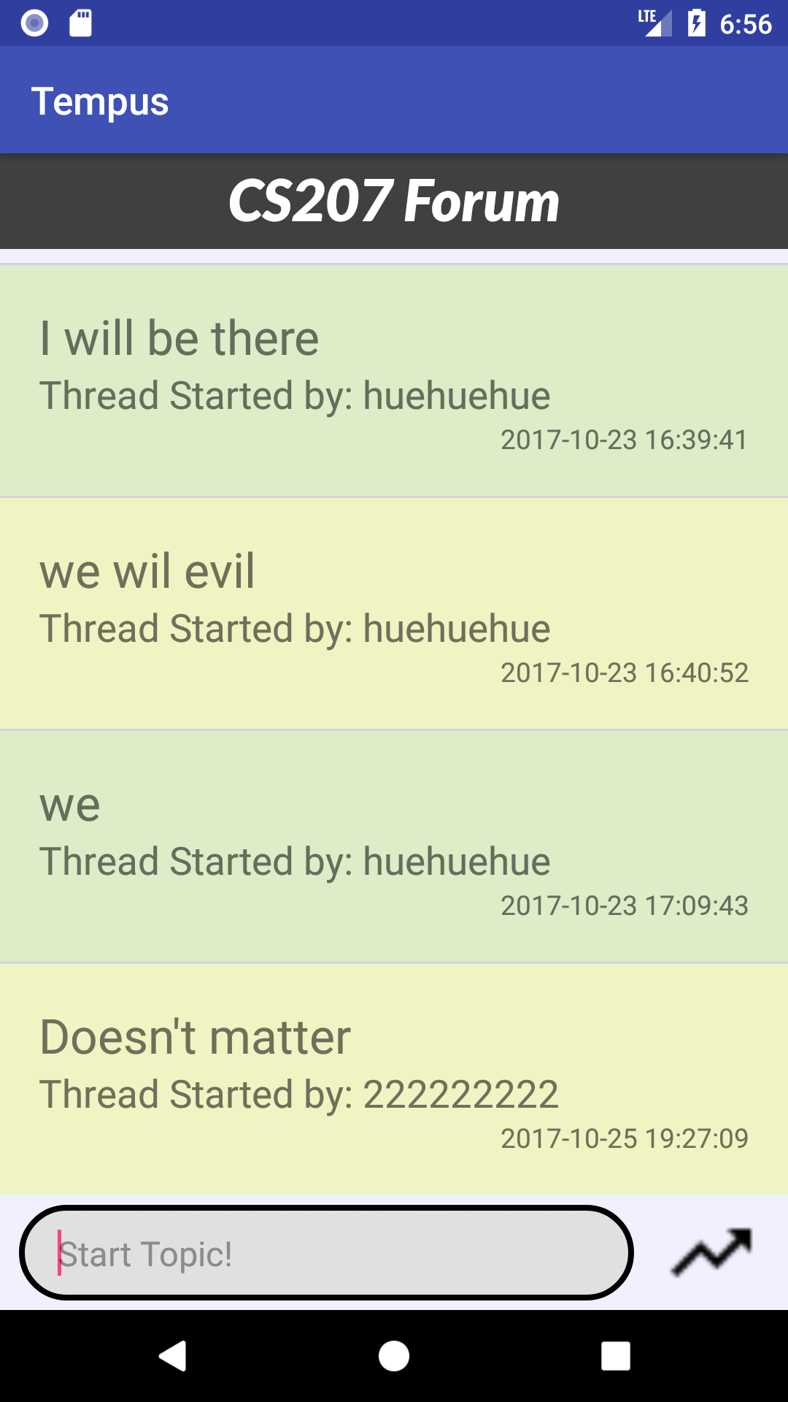
Discussion Forum (Topics)

Slide 18
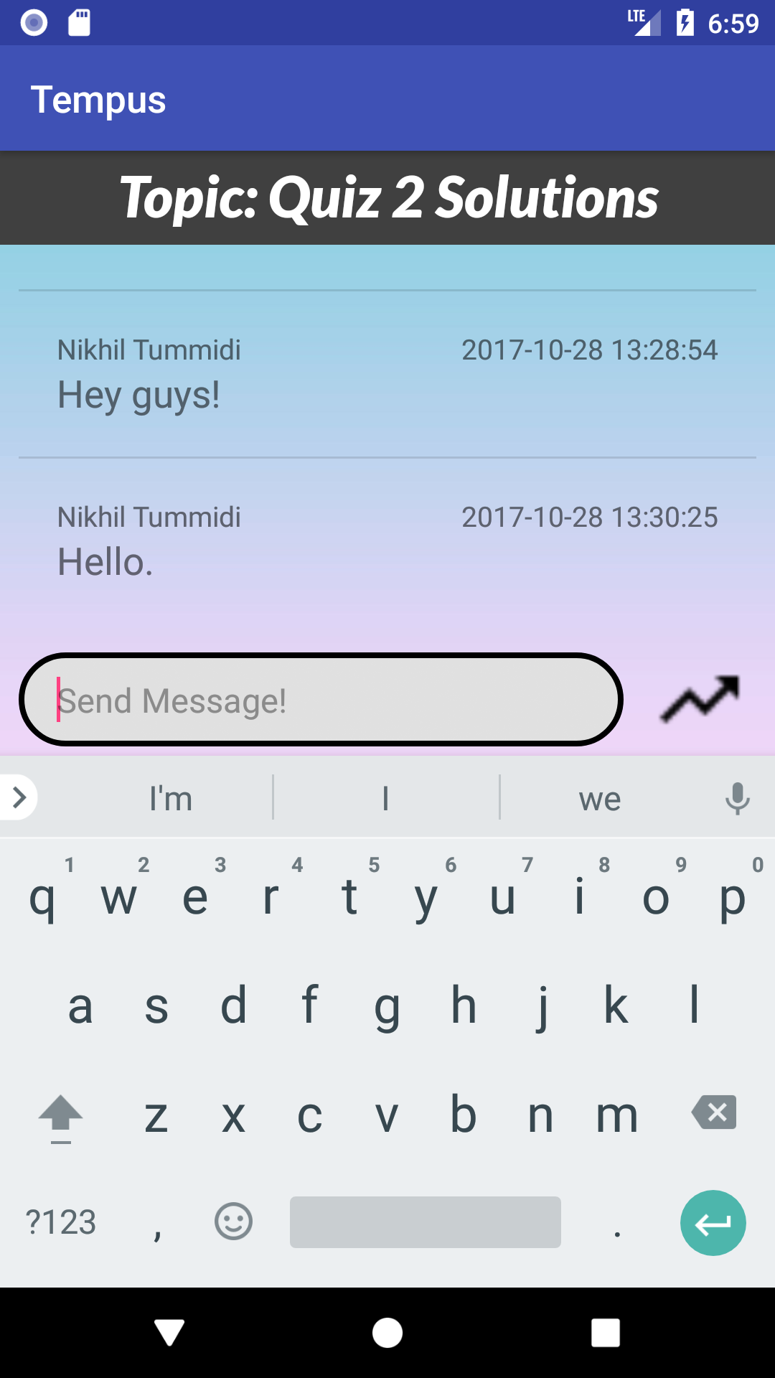
Discussion Forum (Posts)

Slide 19
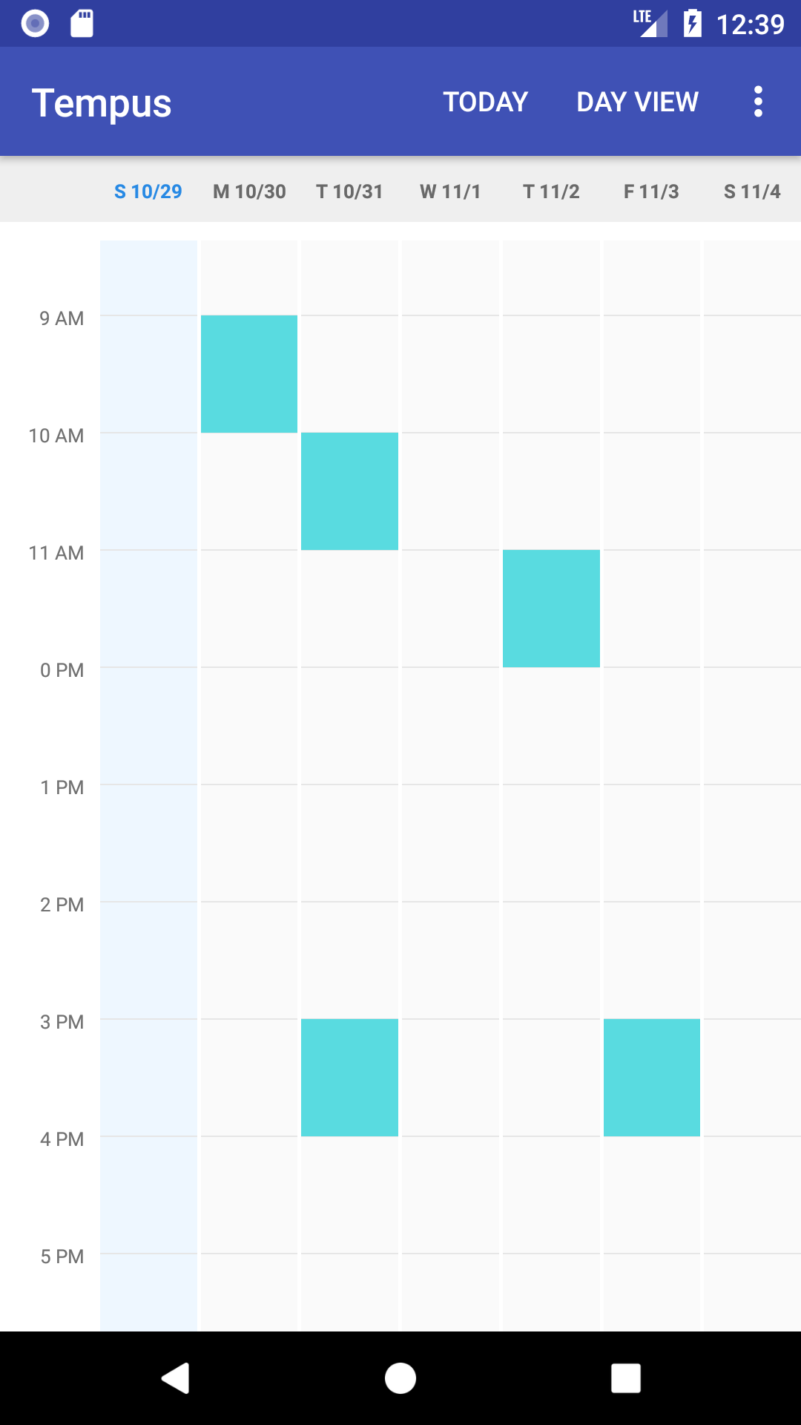
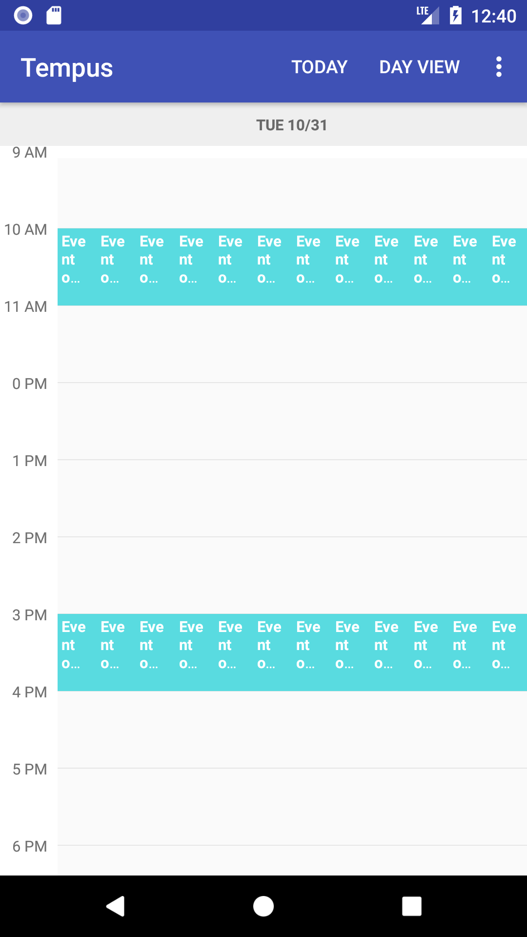
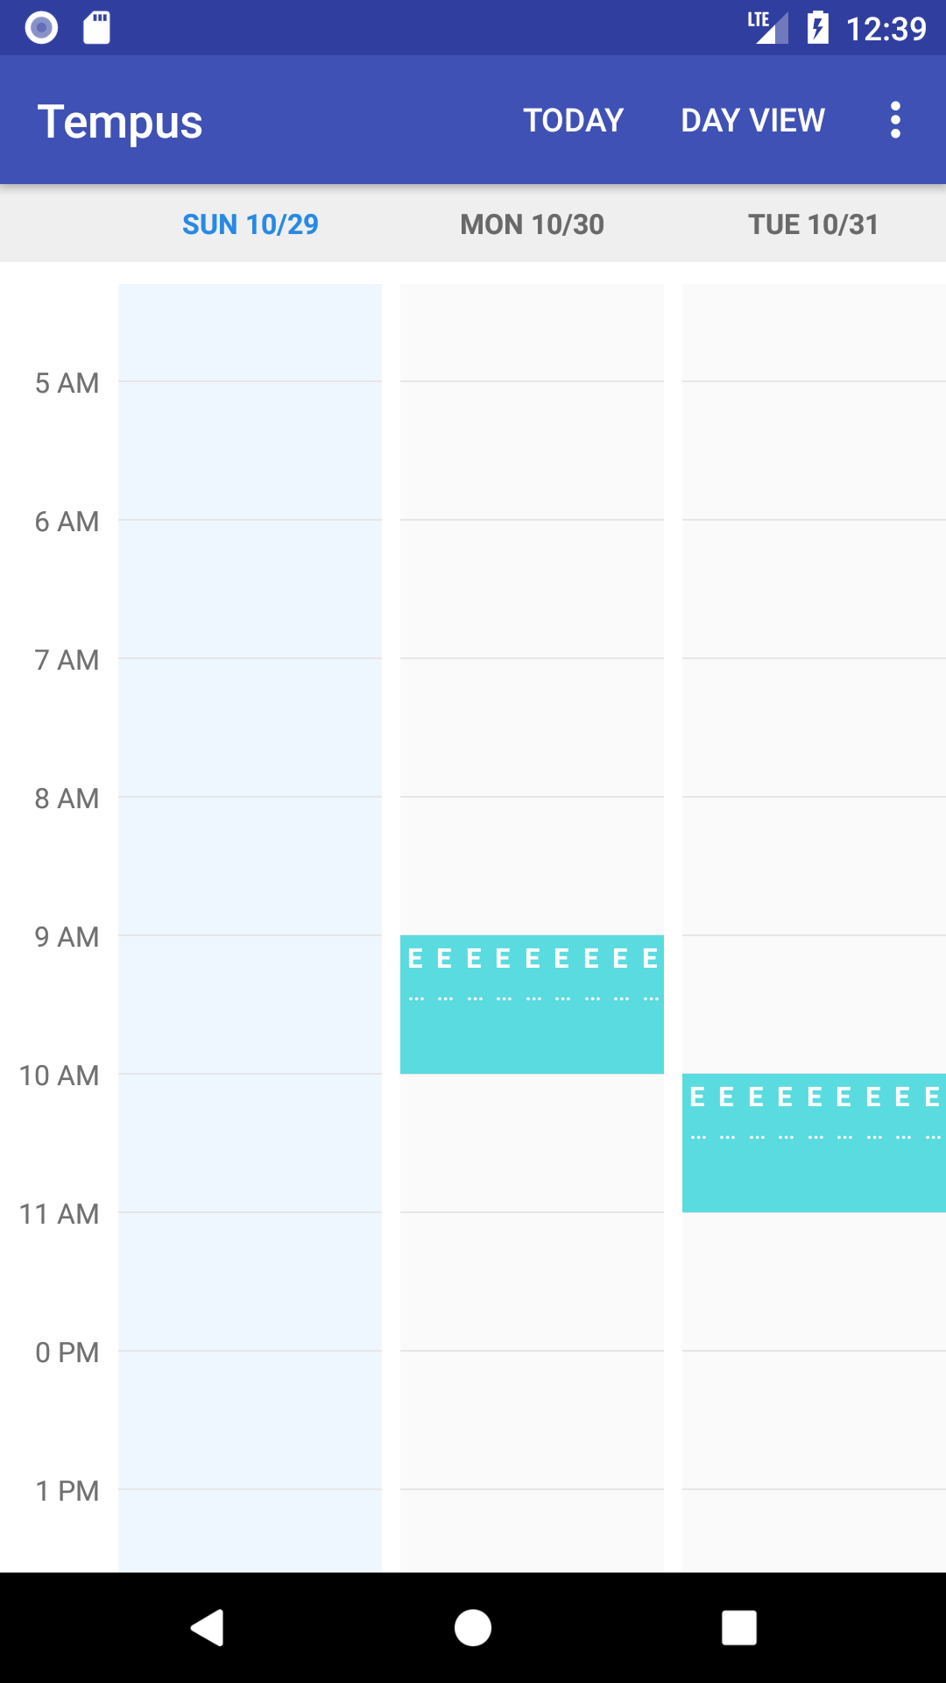
Time Table

Slide 20
References
https://developer.xamarin.com/Recipes/android/
https://www.androidhive.info/2012/05/how-to-connect-android-with-php-mysql/
https://www.tutorialspoint.com/android/android_sqlite_database.htm
https://stackoverflow.com/questions/23031837/android-keep-user-logged-in
https://www.androidhive.info/2012/08/android-session-management-using-shared-preferences/
https://auth0.com/blog/what-is-and-how-does-single-sign-on-work/
https://developer.android.com/reference/android/widget/Button.html
https://developer.xamarin.com/Recipes/android/Controls/ImageButton/Create_An_ImageButton/
https://developers.google.com/google-apps/calendar/quickstart/dotnet
https://gymkhana.iitb.ac.in/sso/doc/

Slide 21
THANK YOU!
Note: Implementation has been described extensively in the project report.

